Slide 1
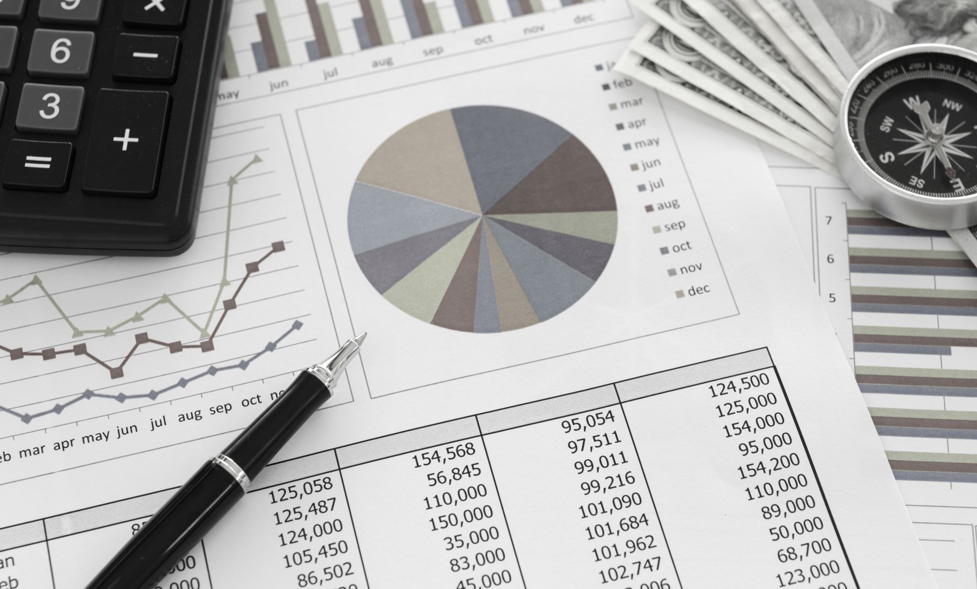
Intern Finance Project 1
By: Gavin Bowen

Slide 2
Project Tasks
Calculate annualized return, annualized volatility, and risk adjusted return for dates up to inception for 29 different asset classes and .
Analyze what should be added to portfolios to maximize risk adjusted return and still achieve investment goals.
Decide on a singular asset class to invest in based on 1-year, 5-years, and 30 years time periods.
Create a summation of dynamic data using excel functions used to compare different asset class metrics during 1-year, 3-year, 5-year, 10-year, and since inception periods.

Slide 3
Annualized Return Data
Asset Classes | % Annualized Return
S&P 500 Momentum | 13.51%
S&P 500 Quality | 13.45%
S&P 500 Low Volatility | 11.70%
S&P 500 Dividend | 11.14%
S&P 500 | 10.89%
S&P 500 Growth | 10.87%
Russell 2000 | 10.82%
NASDAQ-100 | 9.93%
S&P 500 Value | 9.21%
S&P Global BMI Index | 8.20%
MSCI Emerging Markets | 7.88%
Commodity Index | 7.75%
S&P Global REIT Index | 7.73%
9% U.S. Equity Buffer - Jan | 7.60%
MSCI EAFE | 7.20%
MSCI World | 6.93%
MSCI ACWI | 6.79%
US Corporate High Yield Bond Index | 6.21%
15% U.S. Equity Buffer - Jan | 5.96%
30% U.S. Equity Buffer - Jan | 5.56%
MSCI World ex-US | 5.26%
Exchange-Listed Preferred & Hybrid Securities Index | 4.81%
US TIPS Index | 4.66%
US Aggregate Bond Index | 4.59%
US Treasury 20+ Year Index | 4.41%
20% Quarterly U.S. Equity Buffer | 4.25%
US Treasury Bills Index | 4.06%
Municipal Bond Index | 3.91%
U.S. Treausry 1-3 Year Index | 1.81%

Slide 4
Annualized Volatility
Asset Classes | % Volatility
NASDAQ-100 | 27.81%
Russell 2000 | 20.11%
S&P 500 Growth | 19.78%
S&P 500 Dividend | 19.52%
S&P 500 Value | 18.98%
S&P 500 Momentum | 18.74%
MSCI Emerging Markets | 18.33%
S&P 500 Quality | 18.09%
S&P 500 | 17.95%
MSCI World ex-US | 17.01%
Exchange-Listed Preferred & Hybrid Securities Index | 16.86%
S&P Global REIT Index | 16.53%
MSCI World | 16.21%
MSCI ACWI | 15.85%
MSCI EAFE | 15.29%
9% U.S. Equity Buffer - Jan | 15.23%
S&P Global BMI Index | 14.55%
Commodity Index | 14.12%
US Treasury 20+ Year Index | 13.72%
S&P 500 Low Volatility | 13.24%
15% U.S. Equity Buffer - Jan | 11.74%
30% U.S. Equity Buffer - Jan | 9.03%
20% Quarterly U.S. Equity Buffer | 6.33%
US TIPS Index | 5.64%
US Corporate High Yield Bond Index | 5.13%
US Aggregate Bond Index | 4.18%
Municipal Bond Index | 3.14%
U.S. Treasury 1-3 Year Index | 1.42%
US Treasury Bills Index | 0.16%

Slide 5
Risk Adjusted Return
Asset Classes | Risk Adjusted Return
US Treasury Bills Index | 24.9509
U.S. Treasury 1-3 Year Index | 1.2738
Municipal Bond Index | 1.2459
US Corporate High Yield Bond Index | 1.2100
US Aggregate Bond Index | 1.0978
S&P 500 Low Volatility | 0.8832
US TIPS Index | 0.8268
S&P 500 Quality | 0.7438
S&P 500 Momentum | 0.7208
20% Quarterly U.S. Equity Buffer | 0.6717
30% U.S. Equity Buffer - Jan | 0.6150
S&P 500 | 0.6067
S&P 500 Dividend | 0.5709
S&P Global BMI Index | 0.5632
Commodity Index | 0.5493
S&P 500 Growth | 0.5495
Russell 2000 | 0.5379
15% U.S. Equity Buffer - Jan | 0.5075
9% U.S. Equity Buffer - Jan | 0.4990
S&P 500 Value | 0.4854
MSCI EAFE | 0.4709
S&P Global REIT Index | 0.4675
MSCI Emerging Markets | 0.4301
MSCI ACWI | 0.4285
MSCI World | 0.4274
NASDAQ-100 | 0.3569
US Treasury 20+ Year Index | 0.3213
MSCI World ex-US | 0.3094
Exchange-Listed Preferred & Hybrid Securities Index | 0.2850

Slide 6

Observations
S&P 500 Momentum asset class was best for annualized return at 13.51% and still maintained a respectable risk adjusted return relative to the other asset classes.
NASDAQ-100 asset class had a high volatility of 27.81% indicating that investing in tech stocks can be risky
US Treasury Bills Index greatly outperformed every other asset class at at nearly 25 in terms of risk adjusted return, but it is noteworthy to mention it does have a lower annualized return of 4.06%

Slide 7
Portfolio Comparison
Given Portfolio Composition
For portfolio with:
S&P 500 | 60.00%
US Aggregate Bond Index | 40.00%
Desired Portfolio Composition
For porfolio with:
S&P 500 | 50.00%
US Aggregate Bond Index | 20.00%
US Treasury Bills Index | 30.00%
Given Portfolio Results
Annualized Return | 6.72%
Annualized Volatility | 11.50%
Risk Adjusted Return | 0.584
Desired Portfolio Results
Annualized Return | 6.82%
Annualized Volatility | 10.12%
Risk Adjusted Return | 0.674
Explanation
I would personally add 30% of the US Corporate High Yield Bond Index to improve risk adjusted return. This would raise the number from 0.584 to 0.674, nearly an addition of a full 0.1.
This is a solid boost to risk adjusted return in a portfolio due to how balanced it is. It has a nice return of 6.21% while having a lower volatility at 5.31%.
If you do not find something that is balanced, you risk overvaluing either low volatility or high return, taking a hit on your risk adjusted return.
Overall, I think the US Corporate High Yield Bond Index is a great solution to upping your portfolio's risk adjusted return.

Slide 8
Time Sensitive Investments
Time Sensitive Investment Goal Based on Choice of Singular Asset Class
Time Period | Asset Class Chosen | Explanation
1-Year Period | US Treasury Bills Index | Has a very respectable annualized return of 4.06% while maintaining a very good risk adjusted return that nearly reaches 25. Odds are in my favor to get the good return in that very short, fragile one year due to the low volatility/risk nature of the asset class. Avoids the taxes incurred with bond investments and is backed by the government.
5-Year Period | S&P 500 Low Volatility | This asset class still maintains a nice risk adjusted return of 0.8832 but has a high return of 11.70%. The risk adjusted return indicates that with a 5-year period this should be a long enough for the average return of this asset to be the desired 11.70%.
30-Year Period | S&P 500 Momentum | This asset class has the highest return at 13.51%. Due to the extended period of 30 years, I would not consider the volatility of this asset class and rather just focus on the annualized return averages.

Slide 9
Data Validation Comparison
Adjustable Data
Asset | Time Period | Time Sensitive Return | Time Sensitive Volatility | Risk Adjusted Return
S&P 500 | 10-Year | 12.41% | 14.77% | 0.84
Russell 2000 | 10-Year | 7.22% | 18.88% | 0.38

Slide 10
Learned Financial Concepts
Asset class annualized return over different time periods
Asset class annualized volatility over different time periods
Risk adjusted return
Portfolio allocation adjustment effects
Investing depending upon time related goals
Asset class comparison analysis

Slide 11
Learned Excel Functionality
Manually created formulas for vast amounts of data including “(Final/Initial)^(1/n)-1” and “STDEV.S(X) * SQRT(252)” to calculate return and volatility
How to use R1C1 cell style to effectively recreate desired outputs by then using find and replace
Data validation tool
INDEX Excel generated function
MATCH Excel generated function
Dynamic bar graphs, data tables, and pie charts
Cell referencing
Using fn+f4 to make excel data ranges dynamic or static
Formatting
FILTER Excel generated function

